Slide 1

Introduction to Windows API and Dynamic Analysis

Slide 2
Analyzing Windows Programs

Slide 3
The Windows API
https://docs.microsoft.com/en-us/windows/win32/apiindex/windows-api-list
Sometimes referred to as win API or win32
Uses Hungarian notation for function identifiers
Using a prefix naming scheme to identify a variables type
WORD → w
DWORD → dw
Handles → H

Slide 4
Common DLLs
Kernel32.dll: contains core functionality. Contains memory, file and hardware manipulation
Advapi32.dll: access to the Service Manager and Registry
User32.dll: contains user-interface components
Ntdll.dll: interface to the Windows kernel
WSock32.dll / Ws2_32.dll: low-level networking DLLs
Wininet.dll: contains high-level networking functions (HTTP, FTP)

Slide 5
File System Functions
CreateFile
ReadFile and WriteFile
Most of the file system functions operate on handles
Objects that have been opened/created by the kernel
Windows, processes, files
Notes:
Guess which dll

Slide 6
Networking Functions
socket: create socket
bind: attach a socket to a port
listen: setup socket to listen for incoming connections
accept: opens a connection to a remote socket
connect: opens a connection to a remote socket; remote socket must be listening
recv: receives data from socket
send: sends data to socket
InternetOpen: create connection to internet
InternetOpenUrl: connect to a specific URL
InternetReadFile: like ReadFile but for files on the Internet
Notes:
which dll’s

Slide 7
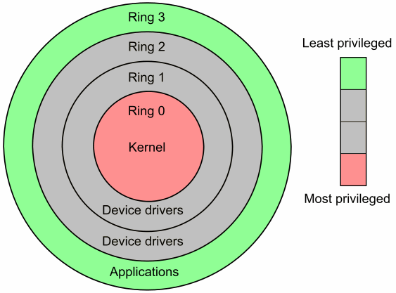
Kernel vs User-Mode
Windows uses two privilege levels: kernel-mode and user-mode
User-mode: where applications run
Each process has its own memory space
Cannot access hardware directly
Crashes are recoverable
Kernel-mode: where OS and driver code run
Each process shares resources and memory
Crashes are unrecoverable (blue screen of death)
No distinction between processes running between privileged or unprivileged users

Slide 8
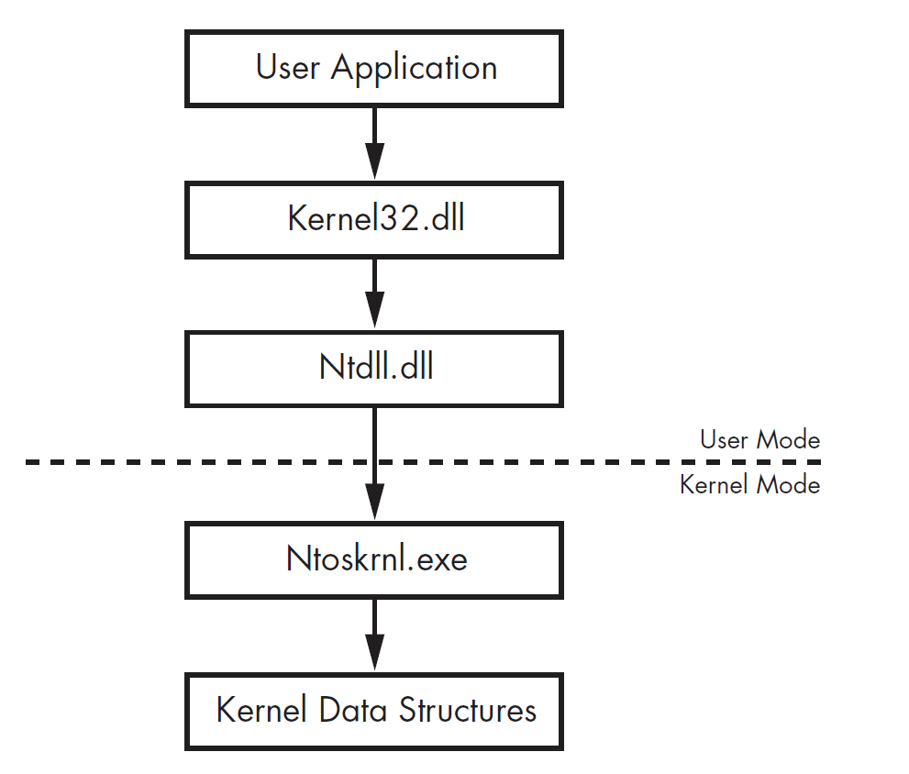
Native API
Native API: lower-level interface for interacting with Windows
user applications can access system DLL’s which call ntdll.dll
ntdll.dll exports the native API that handles interactions between user space and kernel space
native API is implemented in ntoskrnl.exe but exposed to user mode by ntdll.dll
undocumented
programs are not supposed to call ntdll.dll directly, but nothing in the OS will prevent programs from doing so

Slide 9
Dynamic Analysis

Slide 10




Process
Basic Static Analysis
Metadata Analysis
Basic Dynamic Analysis
Black box execution
Advanced Static Analysis
Disassembly and code review
Advanced Dynamic Analysis
Debugging

Slide 11
Basic Dynamic Analysis Tools
Process Monitor (ProcMon)
Records what processes interact with while running
Process Explorer
Regshot
Backs up Windows Registry, can compare two backups
FakeNet
Emulates different network protocols to trick binaries
Wireshark
Packet capture analysis framework

Slide 12
Debugging
Debugger: software use to examine the execution of another program
Source-level: allows you to step through each line of source code
Assembly-level: operates on the assembly code

Slide 13
Kernel-mode vs User-mode Debugging
User-mode debugging: debugging user-mode application
Kernel-mode debugging: debugging kernel-mode applications
Requires two computers. If the kernel is halted at a breakpoint no application can be running on the system
WinDbg supports kernel debugging

Slide 14
Breakpoints
Breakpoints: used to halt program execution to examine a program’s state
Three types:
Software:
what you will use by default when setting a breakpoint in a debugger
Overwrites the first byte of an instruction with 0xCC (INT 3) which is a breakpoint interrupt
Hardware:
Uses dedicated hardware registers
Can only place four at a time
Can be used to break on access instead of execution
Conditional:
Software breakpoints that only trigger if a condition is true

Slide 15
Advanced Dynamic Analysis Tools
OllyDbg
Version 1 only supports 32-bit applications
Version 2 supports 64-bit and 32-bit applications
Extremely popular back in the day
Immunity Debugger
Forked version of OllyDbg 1.10
Supports Python scripting
WinDbg
Mainly used for Kernel level debugging
Put out by Microsoft
x64dbg
Most “modern” debugger
Has a 32-bit version as well that ships with the 64-bit versions
Ida Free
Ida free now ships with a debugger

Slide 16
Debugger Lab

